Slide 1
Lecture 15 Magnetic Circuits

Slide 2
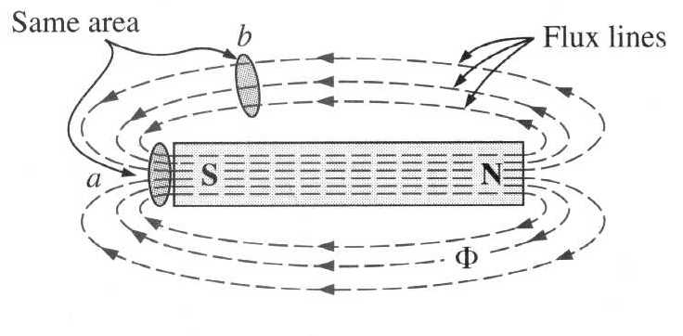
Magnetism
A coil of wire carrying an electric current can be used to magnetise a piece of iron or steel – Property is Magnetism
Magnetic lines of force – Magnetic flux
Magnetic field
I

Slide 3
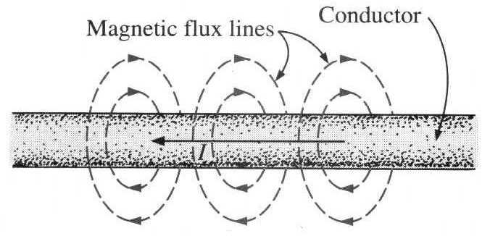
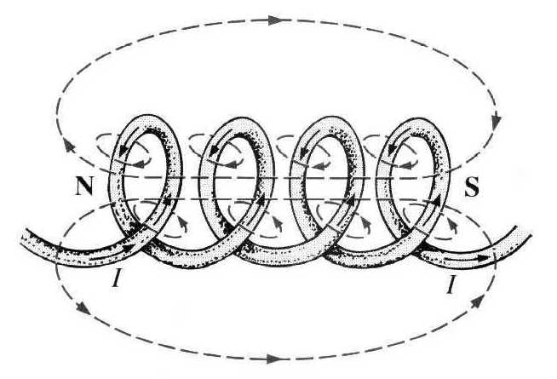
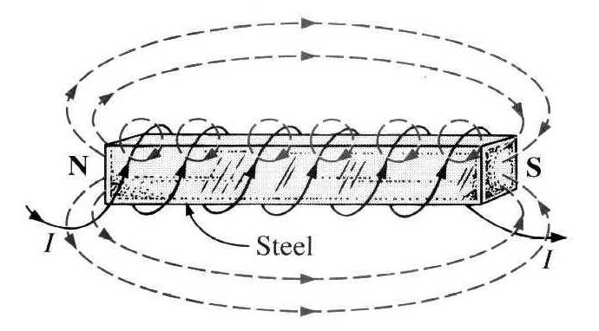
Magnetic Effects of Electric Current
A conductor carrying an electric current will be surrounded by a magnetic field
A conductor may be wound into a coil to increase the strength of the magnetic field
An iron core placed inside the coil will greatly increase the strength magnetic field

Slide 4
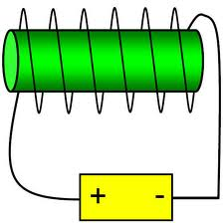
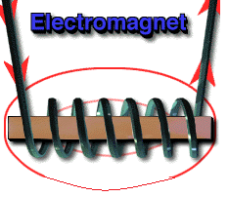
Magnetic Effects of Electric Current
Electromagnets:
Principle: An electric current flowing in a conductor creates a magnetic field around it.
N
Strength of the field is proportional to the amount of current in the coil.
The field disappears when the current is turned off.
A simple electromagnet consists of a coil of insulated wire wrapped around an iron core.
Widely used as components of motors, generators, relays etc.
I

Slide 5
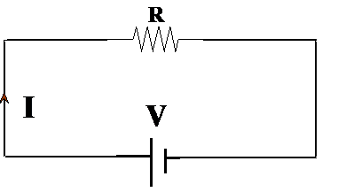
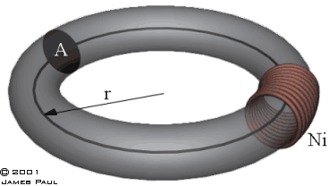
Magnetic circuit
The complete closed path followed by any group of magnetic lines of flux
Equivalent electrical circuit

Slide 6
Basic Definitions
Magneto Motive Force, MMF (F)
Force which drives the magnetic lines of force through a magnetic circuit
MMF, F = ΦS, where ‘Φ’ is the magnetic flux and ‘S’ is the Reluctance of the magnetic path.
Also, For Electromagnets:
where N is the number of turns of the coil and I is the current flowing in the coil
Unit: AT (Ampere Turns)
Analogy: EMF, V=IR
MMF= N I (No. of turns*Current),

Slide 7
Magnetic flux (Φ):
Basic Definitions
Number of magnetic lines of force created in a magnetic circuit.
Unit : Weber (Wb)
Analogy: Electric Current, I

Slide 8
Reluctance [S]
Basic Definitions
Opposition of a magnetic circuit to the setting up of magnetic flux in it.
S=F/ɸ
Unit: AT / Wb
Analogy: Resistance

Slide 9
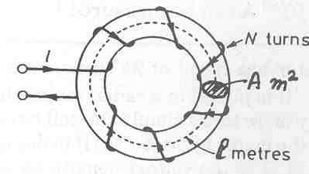
Basic Definitions
Magnetic Flux Density (B):
No. of magnetic lines of force created in a magnetic circuit per unit area normal to the direction of flux lines
B = Φ/A
Unit : Weber/m² (Tesla)
Analogy: Current Density
Magnetic Field Strength (H)
The magneto motive force per meter length of the magnetic circuit
H = (N I) / l
Unit : AT / meter
Analogy: Electric field strength

Slide 10
Basic Definitions
Permeability (µ)
A property of a magnetic material which indicates the ability of magnetic circuit to carry magnetic flux.
μ = B / H
Unit: Henry / meter
Permeability of free space or air or non magnetic material μ₀=4*Π*10⁻⁷ Henry/m
Relative permeability, μ_{r} : μ/μ₀
Analogy: Conductivity

Slide 11
Magnetic Permeability (μ)
In general, we can write B = μH.
μ is called the permeability of the material.
Normally, we write μ = μ_{r} μ₀.
μ_{r} is called relative permeability (just a number).

Slide 12
Analogy with Electric circuits
Magnetic circuit
Similarities:
Electric circuit |  | Magnetic circuit
Quantity | Unit | Quantity | Unit
EMF (E=IR) | Volt (V) | MMF (F=ɸS) | Ampere-turns
Current (I) | Ampere (A) | Flux (ɸ) | Weber (Wb)
Current density (J) | A/ m² | Flux density (B) | Wb / m² or Tesla
Resistance (R) | Ohm (Ω) | Reluctance (S) | Ampere-turns/Wb
Electric field strength (E) | Volts/m | Magnetic field strength (H) | Ampere-turns/m
Conductivity (σ) σ=l/RA | Siemen/m | Permeability, µ µ=l/SA | Henry/m
‘l’ is the length and ‘A ‘is the area of cross section of the conductor

Slide 13
Differences between electric and magnetic circuits
Magnetic circuit
In electrical circuit current actually flows.
In magnetic circuit flux is created, and it is not a flow.

Slide 14
Example 1
Calculate the magnetomotive force (mmf) required to produce a flux of 0.015 Wb across an air gap of 2.5 mm long, having an effective area of 200 cm².
Solution :

Slide 15
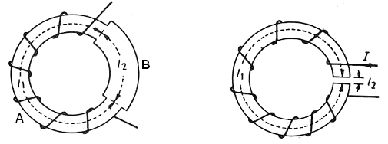
Composite Magnetic Circuit
Case 1 :

Slide 17
Case 2 : (with air gap)
Total reluctance,

Slide 18
Since the relative permeability μ_{r} (= μ₁/ μ₀) of steel is very large (of the order of thousand), the major contribution in the total reluctance R is by the air-gap, though its length l₂ may be quite small (say, a few millimetres).

Slide 19
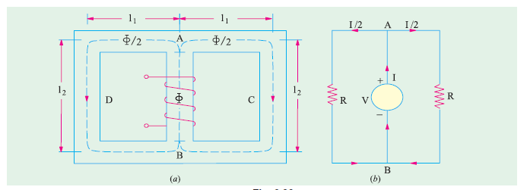
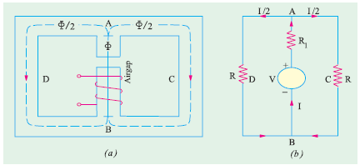
Parallel and Series-Parallel Magnetic Circuits

Slide 20
Thank You

